Slide 1


Data Science for the Internet of Things
25
PART V · DATA SCIENCE IN SYSTEMS CONTEXT
CHAPTER 25 · WEEK 15
Data Science — From Foundations to Intelligent Systems
LECTURER
Dr. Mustafa Hameed
THE ISLAMIA UNIVERSITY OF BAHAWALPUR
Bahawalpur, Pakistan
Department of Information Technology · BSIT · Fall 2026
Notes:
Chapter 25: Data Science for the Internet of Things. Part 5 — Data Science in Systems Context. Week 15: Data science for IoT and cybersecurity. Handout pages 162–167.

Slide 2

Where this chapter sits
THE COURSE
PART I
PART II
PART III
PART IV
PART V
PART VI
1
2
3
4
5
6
7
8
9
10
11
12
13
14
15
16
17
18
19
20
21
22
23
24
25
26
27
28
29
30
31
32
Data Science for the Internet of Things
BUILDS ON
USED LATER IN
Ch 15 Feature Engineering and Ensembles
— the course ends here
Ch 16 Unsupervised Learning and Anomaly Detection
Ch 19 Sequences, Time Series and Streaming Analytics
Ch 24 Cloud and Edge Computing for Data Science
Data Science · Chapter 25 · Data Science for the Internet of Things
Handout p. 162 2
Notes:
Place the chapter. Before you start: The four chapters this one is built on: Chapter 19 (streaming, windowing, drift), Chapter 16 (anomaly detection without labels), Chapter 15 (window aggregations) and Chapter 24 (edge inference). This is the chapter those were preparing you for.

Slide 3

What you will be able to do
LEARNING OUTCOMES
By the end of this chapter you will be able to:
1
Describe the IoT reference architecture and where analytics sits within it.
2
Characterise telemetry data and the failure modes specific to sensors.
3
Design a predictive maintenance system end to end, from framing to deployment.
4
Apply sensor fusion and explain why multiple weak sensors beat one good one.
5
Evaluate an IoT model against operational rather than statistical criteria.
Data Science · Chapter 25 · Data Science for the Internet of Things
Handout p. 162 3
Notes:
Read these out: they are the chapter's contract with the room. Each click adds one.

Slide 4

Vocabulary for this chapter
KEY TERMS
telemetry
sensor
actuator
MQTT
gateway
device twin
sampling rate
sensor drift
calibration
sensor fusion
predictive maintenance
remaining useful life
digital twin
over-the-air update
Each term is defined where it first matters — not here.
Data Science · Chapter 25 · Data Science for the Internet of Things
Handout p. 162 4
Notes:
Do not define these now; they arrive one at a time. This slide is for the students' notes. Terms: telemetry; sensor; actuator; MQTT; gateway; device twin; sampling rate; sensor drift; calibration; sensor fusion; predictive maintenance; remaining useful life; digital twin; over-the-air update.

Slide 5
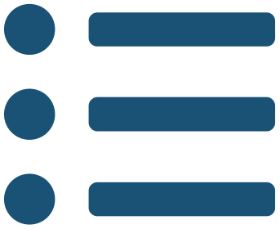
In this chapter
IN THIS CHAPTER
25.1
The Architecture, and Where Data Science Lives in It
p. 162 ›
25.2
What Telemetry Data Is Like
p. 162 ›
25.3
Sensor Fusion
p. 163 ›
25.4
Predictive Maintenance End to End
p. 164 ›
Data Science · Chapter 25 · Data Science for the Internet of Things
Handout pp. 162–167 5
Notes:
The route through the chapter. Each row is a link: click it to jump to that section in the slide show.

Slide 6
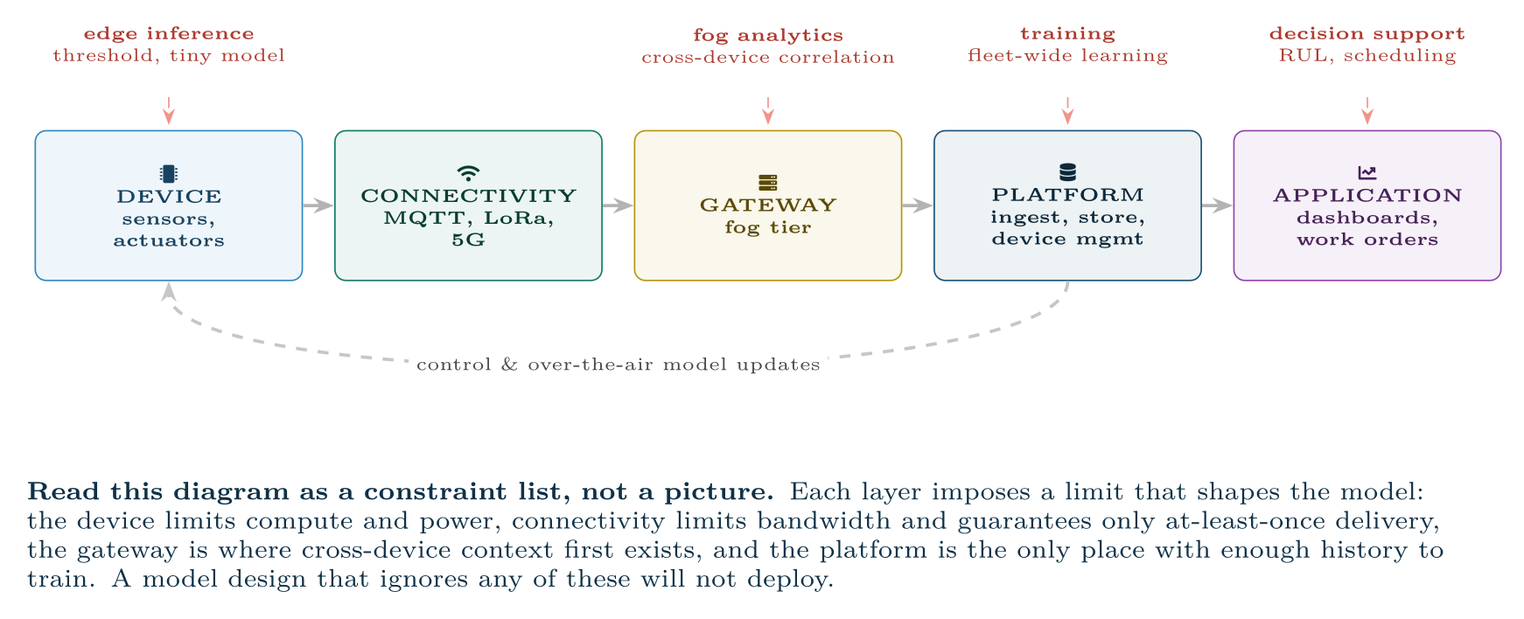
The IoT reference architecture, annotated with where data science actually runs
FIGURE 25.1
Analytics is not a single box at the end — it is distributed across four tiers with different capabilities.
Data Science · Chapter 25 · Data Science for the Internet of Things
§25.1 · Handout p. 162 6
Notes:
Figure 25.1 (handout p. 162): The IoT reference architecture, annotated with where data science actually runs. Analytics is not a single box at the end — it is distributed across four tiers with different capabilities.

Slide 7
What Telemetry Data Is Like
SECTION 2 OF 4
25.2
25.1 The Architecture, and Where Data Science Lives in It
25.2 What Telemetry Data Is Like
25.3 Sensor Fusion
25.4 Predictive Maintenance End to End
Data Science · Chapter 25
Handout §25.2 7
Notes:
Pause. Name the question this section answers.

Slide 8

What Telemetry Data Is Like
AT A GLANCE
Property | Consequence | What you must do
Very high volume | Cannot store or query raw indefinitely | Pre-aggregate to minute/hour grains; retain raw only briefly (Chapter 23)
Highly autocorrelated | Effective sample size row count | Never trust a p-value computed on raw readings (Chapter 9)
Irregular timestamps | Clocks drift across a fleet | Resample to a fixed grid; use the gateway’s clock, not the device’s
Duplicates | At-least-once delivery guarantees them | Idempotent ingestion keyed on (device, timestamp)
Out of order | Network delay and buffering | Watermarks; decide how long to wait (Chapter 19)
Missing bursts | Connectivity loss | Forward fill with a cap, plus a was_missing flag
Extremely imbalanced labels | Equipment rarely fails | Anomaly detection, not classification (Chapter 16)
Data Science · Chapter 25 · Data Science for the Internet of Things
§25.2 · Handout p. 162 8
Notes:
Do not read the table row by row: pick the row the room is most likely to get wrong and ask why.

Slide 9

The Failure Mode That Catches Everyone
WATCH OUT
A sensor that fails often reports a perfectly plausible constant. Nothing is null, nothing is out of range, no error is logged — and the model sees a machine in flawless health. Add a check for variance too low alongside your range checks. A temperature that has not changed by 0.01 degrees in six hours is not a stable process; it is a dead thermistor.
Data Science · Chapter 25 · Data Science for the Internet of Things
§25.2 · Handout p. 162 9
Notes:
Read the box aloud, then ask for an example from the room before moving on.

Slide 10
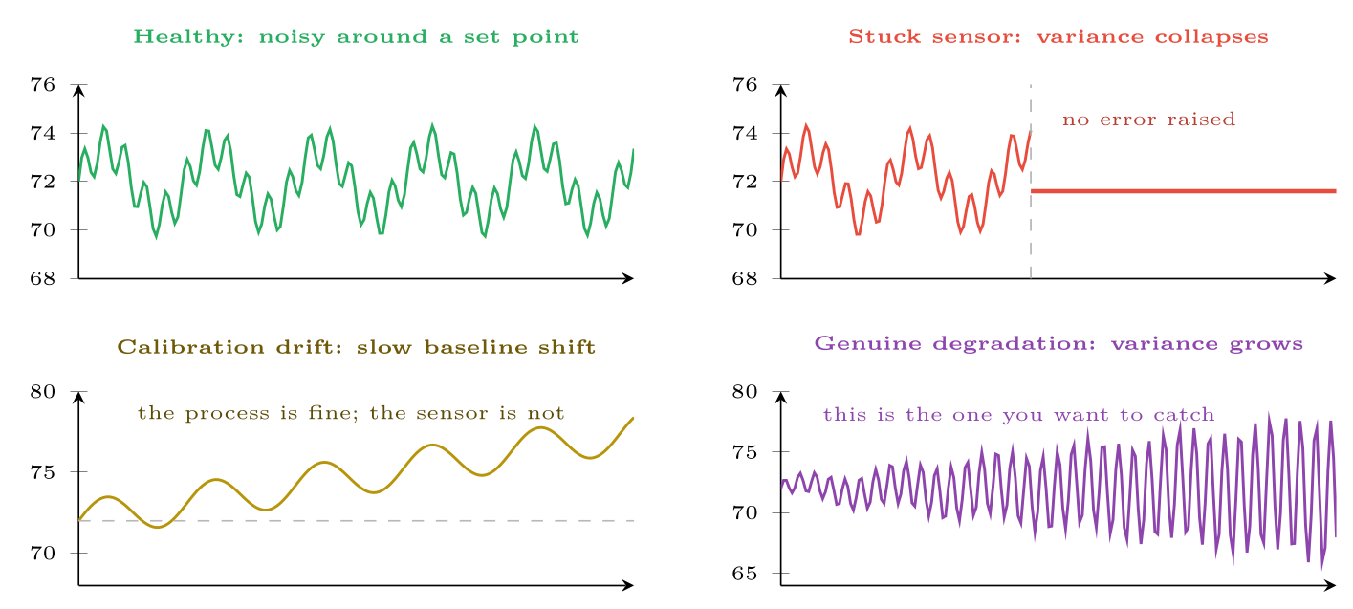
Four telemetry signatures
FIGURE 25.2
Distinguishing a failing sensor (top right, bottom left) from a failing machine (bottom right) is the central diagnostic skill in IoT analytics — and range checks alone cannot do it.
Data Science · Chapter 25 · Data Science for the Internet of Things
§25.2 · Handout p. 162 10
Notes:
Figure 25.2 (handout p. 163): Four telemetry signatures. Distinguishing a failing sensor (top right, bottom left) from a failing machine (bottom right) is the central diagnostic skill in IoT analytics — and range checks alone cannot do it.

Slide 11
Sensor Fusion
SECTION 3 OF 4
25.3
25.1 The Architecture, and Where Data Science Lives in It
25.2 What Telemetry Data Is Like
25.3 Sensor Fusion
25.4 Predictive Maintenance End to End
Data Science · Chapter 25
Handout §25.3 11
Notes:
Pause. Name the question this section answers.

Slide 12

Sensor Fusion
DEFINITION
Combining readings from several sensors to produce an estimate better than any one of them. Sensors fail and drift independently, so their errors partly cancel — the same argument that makes ensembles work (Chapter 15), applied to hardware.
Data Science · Chapter 25 · Data Science for the Internet of Things
§25.3 · Handout p. 163 12
Notes:
Read the box aloud, then ask for an example from the room before moving on.

Slide 13

Why Three Cheap Sensors Beat One Good One
WORKED EXAMPLE
A bearing is monitored for overheating.
Single sensor. One precise thermometer, σ = 0.5°C. If it sticks (Figure 25.2, top right), you have no monitoring at all and no way to know.
Three cheap sensors, each σ = 1.5°C, averaged. Because their errors are independent, the standard error of the mean is
— worse than the single precise sensor on accuracy alone.
But now add the disagreement check. If one sensor reads 71.4 and the other two read 77.2 and 77.6, the odd one out is identifiable and can be excluded. With a single sensor that comparison does not exist.
Data Science · Chapter 25 · Data Science for the Internet of Things
§25.3 · Handout p. 163 13
Notes:
Each click adds one step of the working. Ask for the next number before you reveal it.

Slide 14
Why Three Cheap Sensors Beat One Good One (continued)
WORKED EXAMPLE
And add a different physical quantity. Combine temperature with vibration and current draw. A failing bearing raises all three; a failing thermistor moves only temperature. This is the decisive advantage: fusion across different physics distinguishes a broken machine from a broken sensor, which no amount of precision in one channel can achieve.
Conclusion: the design goal is not the most accurate sensor but the most diagnosable sensor set. Redundancy buys fault detection; diversity buys attribution.
Data Science · Chapter 25 · Data Science for the Internet of Things
§25.3 · Handout p. 163 14
Notes:
Each click adds one step of the working. Ask for the next number before you reveal it.

Slide 15
Predictive Maintenance End to End
SECTION 4 OF 4
25.4
25.1 The Architecture, and Where Data Science Lives in It
25.2 What Telemetry Data Is Like
25.3 Sensor Fusion
25.4 Predictive Maintenance End to End
Data Science · Chapter 25
Handout §25.4 15
Notes:
Pause. Name the question this section answers.

Slide 16
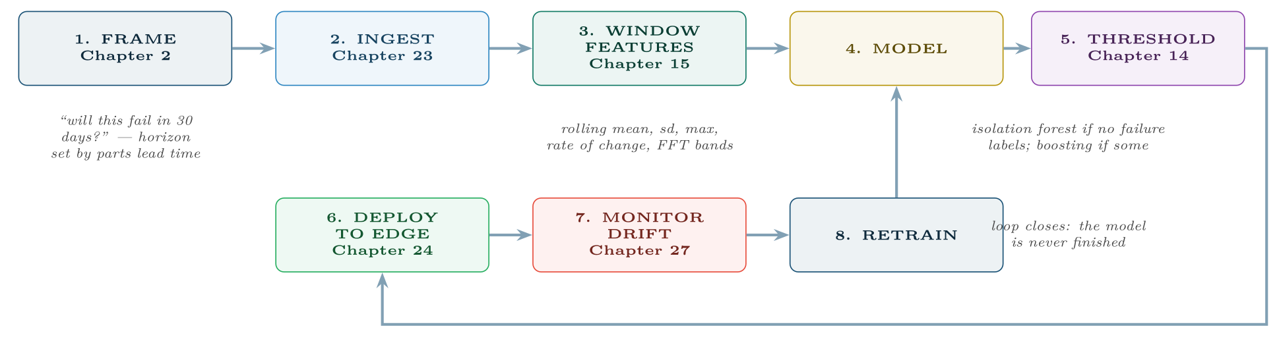
Predictive maintenance as an assembly of earlier chapters
FIGURE 25.3
Nothing here is new technique — the contribution of this chapter is the ordering, the constraints and the operational criteria.
Data Science · Chapter 25 · Data Science for the Internet of Things
§25.4 · Handout p. 164 16
Notes:
Figure 25.3 (handout p. 164): Predictive maintenance as an assembly of earlier chapters. Nothing here is new technique — the contribution of this chapter is the ordering, the constraints and the operational criteria.

Slide 17
Framing a Predictive Maintenance Model Properly
WORKED EXAMPLE
Applying the six framing questions of Chapter 2 to 400 motors.
1. Decision: whether to schedule a motor for inspection in this week’s maintenance window. Not “predict failure” — there is a specific action with a specific capacity.
2. Unit: one motor on one day. So the modelling table has 400 × 365 = 146,000 rows per year, not 12 billion raw readings.
3. Target: does this motor fail within the next 30 days? The horizon comes from parts lead time (3 weeks) plus scheduling slack, not from the data.
4. Timing: only telemetry up to and including today. Any feature computed over the failure window is a leak (Chapter 7) — and in this domain the leak is easy to introduce, because maintenance records are timestamped when they are entered, often after the failure.
Data Science · Chapter 25 · Data Science for the Internet of Things
§25.4 · Handout p. 164 17
Notes:
Each click adds one step of the working. Ask for the next number before you reveal it.

Slide 18
Framing a Predictive Maintenance Model Properly (continued)
WORKED EXAMPLE
5. Criterion: prevent ≥ 80% of unplanned stoppages with ≤ 5 unnecessary teardowns per 100 motors per year. Note this is recall-at-fixed-precision, expressed in the operations manager’s units.
6. Baseline: fixed-interval servicing every 90 days, which currently catches about 45% of failures and performs 4 inspections per motor per year. The model must beat that, not beat random.
What this framing prevents. Without question 2, someone builds a model on raw readings and reports 99.99% accuracy (nearly every reading is from a healthy motor). Without question 6, a model catching 60% of failures sounds impressive until you notice the calendar already catches 45% for free.
Data Science · Chapter 25 · Data Science for the Internet of Things
§25.4 · Handout p. 164 18
Notes:
Each click adds one step of the working. Ask for the next number before you reveal it.

Slide 19
Evaluate on Operational Criteria, Not Statistical Ones
WATCH OUT
Report these four numbers, in this order:
1. Unplanned stoppages prevented per year — the business metric.
2. Unnecessary inspections per year — the cost of false positives, in technician-days.
3. Warning lead time — a correct prediction 2 days ahead is useless if parts take 3 weeks. A model with lower recall but longer lead time is often the better model.
4. Alerts per technician per week — if this exceeds what the team can act on, the system will be ignored regardless of its PR-AUC.
Point 3 is the one students miss: for maintenance, when you are right matters as much as whether.
Data Science · Chapter 25 · Data Science for the Internet of Things
§25.4 · Handout p. 164 19
Notes:
Read the box aloud, then ask for an example from the room before moving on.

Slide 20
Digital Twin
DEFINITION
A live software model of a physical asset, continuously updated from its telemetry. It supports asking counterfactual questions — “what happens if we run this pump 20% faster?” — without touching the equipment, and provides a simulated baseline against which real behaviour can be compared.
Data Science · Chapter 25 · Data Science for the Internet of Things
§25.4 · Handout p. 164 20
Notes:
Read the box aloud, then ask for an example from the room before moving on.

Slide 21





Four lenses: IoT Analytics
FOUR LENSES
LEARNING ANALYTICS
PROJECT MANAGEMENT
IoT enters the campus as occupancy sensors, lab equipment usage, library gate counts and environmental monitoring.
IoT projects are unusually hard to manage and worth studying as a project type.
INTERNET OF THINGS
CYBERSECURITY
This chapter is the IoT lens in full.
IoT devices are a serious and growing attack surface: default credentials, firmware that is never patched, and plaintext protocols.
Data Science · Chapter 25 · Data Science for the Internet of Things
Handout p. 167 21
Notes:
The same method, four domains. Each of the next four slides opens one lens in full.

Slide 22

Learning Analytics: IoT Analytics
FOUR LENSES
LEARNING ANALYTICS
Project Management
IoT enters the campus as occupancy sensors, lab equipment usage, library gate counts and environmental monitoring. Room-occupancy telemetry against timetable data reveals which sessions are genuinely attended — objectively, without a register. Deploy this carefully: sensing that can identify individuals’ movements is surveillance, and requires the consent and proportionality analysis of Chapter 28, not merely a privacy notice.
Internet of Things
Cybersecurity
Data Science · Chapter 25 · Data Science for the Internet of Things
Handout p. 167 22
Notes:
Learning Analytics. IoT enters the campus as occupancy sensors, lab equipment usage, library gate counts and environmental monitoring. Room-occupancy telemetry against timetable data reveals which sessions are genuinely attended — objectively, without a register. Deploy this carefully: sensing that can identify individuals’ movements is surveillance, and requires the consent and proportionality analysis of Chapter 28, not merely a privacy notice.

Slide 23

Project Management: IoT Analytics
FOUR LENSES
PROJECT MANAGEMENT
Learning Analytics
IoT projects are unusually hard to manage and worth studying as a project type. They combine hardware lead times, firmware, connectivity contracts and analytics, so the critical path runs through procurement rather than code. Pilot on 20 devices before committing to 4,000 — the failure modes of a fleet are not visible at bench scale, and the cost of discovering them after deployment is measured in truck rolls.
Internet of Things
Cybersecurity
Data Science · Chapter 25 · Data Science for the Internet of Things
Handout p. 167 23
Notes:
Project Management. IoT projects are unusually hard to manage and worth studying as a project type. They combine hardware lead times, firmware, connectivity contracts and analytics, so the critical path runs through procurement rather than code. Pilot on 20 devices before committing to 4,000 — the failure modes of a fleet are not visible at bench scale, and the cost of discovering them after deployment is measured in truck rolls.

Slide 24

Internet of Things: IoT Analytics
FOUR LENSES
INTERNET OF THINGS
Learning Analytics
This chapter is the IoT lens in full. The distilled version: aggregate before you model, treat sensor faults as a distinct class from machine faults, place inference where the latency budget demands, and evaluate on stoppages prevented rather than on AUC.
Project Management
Cybersecurity
Data Science · Chapter 25 · Data Science for the Internet of Things
Handout p. 167 24
Notes:
Internet of Things. This chapter is the IoT lens in full. The distilled version: aggregate before you model, treat sensor faults as a distinct class from machine faults, place inference where the latency budget demands, and evaluate on stoppages prevented rather than on AUC.

Slide 25

Cybersecurity: IoT Analytics
FOUR LENSES
CYBERSECURITY
Learning Analytics
IoT devices are a serious and growing attack surface: default credentials, firmware that is never patched, and plaintext protocols. Two data science consequences follow. First, compromised devices produce anomalous telemetry, so your maintenance anomaly detector is also, incidentally, an intrusion detector — and you should treat unexplained anomalies as a security question, not only an engineering one. Second, telemetry can be forged: an attacker who controls a device can send readings that look healthy while the machine is damaged, or that trigger unnecessary shutdowns. Sensor fusion across independent physics is a partial defence, because forging three correlated channels consistently is much harder than forging one.
Project Management
Internet of Things
Data Science · Chapter 25 · Data Science for the Internet of Things
Handout p. 167 25
Notes:
Cybersecurity. IoT devices are a serious and growing attack surface: default credentials, firmware that is never patched, and plaintext protocols. Two data science consequences follow. First, compromised devices produce anomalous telemetry, so your maintenance anomaly detector is also, incidentally, an intrusion detector — and you should treat unexplained anomalies as a security question, not only an engineering one. Second, telemetry can be forged: an attacker who controls a device can send readings that look healthy while the machine is damaged, or that trigger unnecessary shutdowns. Sensor fusion across independent physics is a partial defence, because forging three correlated channels consistently is much harder than forging one.

Slide 26

Try it yourself: Telemetry to Alert
TRY IT YOURSELF
WHAT YOU WILL DO
1. Resample to a fixed grid; device clocks cannot be trusted
2. Sensor health checks BEFORE any modelling
3. Window features (Chapter 15)
4. Unsupervised: there are no failure labels
5. Alert on PERSISTENCE, not on a single reading
THIS WEEK'S LAB
WHAT YOU WILL RUN
Week 15: Telemetry to alert; per-entity baselines & evasion test
1 listing, 47 lines of Python
Data Science · Chapter 25 · Data Science for the Internet of Things
§25.4 · Handout p. 164 26
Notes:
Say what the room will have at the end of the lab, then let them start. Circulate rather than lecture.

Slide 27
Telemetry to Alert
LAB · STEP 1 OF 6
Set-up
Python
1
2
import pandas as pd, numpy as np
from sklearn.ensemble import IsolationForest
Data Science · Chapter 25 · Data Science for the Internet of Things
§25.4 · Handout p. 164 27
Notes:
Step 1: Set-up. Read the code aloud; ask what each line would print before running it.

Slide 28
Telemetry to Alert
LAB · STEP 2 OF 6
Resample to a fixed grid; device clocks cannot be trusted
Python
3
4
5
6
7
8
# --- 1. resample to a fixed grid; device clocks cannot be trusted -------
t = (raw.set_index("gateway_ts") # gateway clock, not device clock
.groupby("device_id")
.resample("1min")
.agg(temp=("temp", "mean"), vib=("vib", "mean"),
current=("current", "mean"), n=("temp", "size")))
Data Science · Chapter 25 · Data Science for the Internet of Things
§25.4 · Handout p. 164 28
Notes:
Step 2: Resample to a fixed grid; device clocks cannot be trusted. Read the code aloud; ask what each line would print before running it.

Slide 29
Telemetry to Alert
LAB · STEP 3 OF 6
Sensor health checks BEFORE any modelling
Python
9
10
11
12
13
14
15
16
17
18
# --- 2. sensor health checks BEFORE any modelling ----------------------
w = 60 # one hour
health = t.groupby("device_id").rolling(w, min_periods=30).agg(["std", "mean"])
stuck = health[("temp", "std")] < 0.01 # dead sensor, not a stable process
missing = t["n"] == 0 # no readings arrived at all
drifted = (health[("temp", "mean")]
- health[("temp", "mean")].groupby("device_id").transform("first")).abs() > 5
t["sensor_suspect"] = stuck | missing | drifted # exclude from training; alert separately
Data Science · Chapter 25 · Data Science for the Internet of Things
§25.4 · Handout p. 164 29
Notes:
Step 3: Sensor health checks BEFORE any modelling. Read the code aloud; ask what each line would print before running it.

Slide 30
Telemetry to Alert
LAB · STEP 4 OF 6
Window features (Chapter 15)
Python
19
20
21
22
23
24
25
26
27
28
29
30
31
# --- 3. window features (Chapter 15) -----------------------------------
g = t.groupby("device_id")
feat = pd.DataFrame(index=t.index)
for col in ("temp", "vib", "current"):
feat[f"{col}_mean_1h"] = g[col].transform(lambda s: s.rolling(60).mean())
feat[f"{col}_std_1h"] = g[col].transform(lambda s: s.rolling(60).std())
feat[f"{col}_max_24h"] = g[col].transform(lambda s: s.rolling(1440).max())
feat[f"{col}_slope_24h"] = g[col].transform(
lambda s: s.rolling(1440).apply(lambda v: np.polyfit(range(len(v)), v, 1)[0],
raw=True))
# rising variance is the degradation signature of Figure 25.2, bottom right
feat["vib_var_ratio"] = feat["vib_std_1h"] / g["vib"].transform(
lambda s: s.rolling(10080).std()) # this hour vs this week
Data Science · Chapter 25 · Data Science for the Internet of Things
§25.4 · Handout p. 164 30
Notes:
Step 4: Window features (Chapter 15). Read the code aloud; ask what each line would print before running it.

Slide 31
Telemetry to Alert
LAB · STEP 5 OF 6
Unsupervised: there are no failure labels
Python
32
33
34
35
# --- 4. unsupervised: there are no failure labels ----------------------
train = feat[~t["sensor_suspect"]].dropna()
iso = IsolationForest(contamination=0.005, random_state=0).fit(train)
feat["score"] = -iso.score_samples(feat.fillna(0))
Data Science · Chapter 25 · Data Science for the Internet of Things
§25.4 · Handout p. 164 31
Notes:
Step 5: Unsupervised: there are no failure labels. Read the code aloud; ask what each line would print before running it.

Slide 32
Telemetry to Alert
LAB · STEP 6 OF 6
Alert on PERSISTENCE, not on a single reading
Python
36
37
38
39
40
41
42
# --- 5. alert on PERSISTENCE, not on a single reading ------------------
# One anomalous minute is noise. Six of the last ten is a signal.
flag = feat["score"] > np.percentile(feat["score"], 99.5)
feat["alert"] = flag.groupby(level="device_id").transform(
lambda s: s.rolling(10).sum() >= 6)
print(feat.groupby(level="device_id")["alert"].sum().sort_values(ascending=False).head())
Data Science · Chapter 25 · Data Science for the Internet of Things
§25.4 · Handout p. 164 32
Notes:
Step 6: Alert on PERSISTENCE, not on a single reading. Read the code aloud; ask what each line would print before running it.

Slide 33
What the lab shows
TRY IT YOURSELF
Step 5 is the one that makes this deployable. Alerting on every anomalous reading generates hundreds of alerts a day and the system is switched off within a week. Requiring persistence trades a little detection latency for a false-alarm rate technicians will tolerate — the practical form of the base-rate argument from Chapter 6.
Data Science · Chapter 25 · Data Science for the Internet of Things
§25.4 · Handout p. 164 33
Notes:
Read the box aloud, then ask for an example from the room before moving on.

Slide 34

A temperature sensor has reported 71.6°C exactly for eight hours. Range and null checks both pass. What is wrong, and what check catches it?
CHECKPOINT 1 OF 3
Discuss with the person next to you, then advance.
Data Science · Chapter 25 · Data Science for the Internet of Things
Handout p. 167 · answers in Appendix D 34
Notes:
Ask the room. Do not advance until someone commits to an answer.

Slide 35

A temperature sensor has reported 71.6°C exactly for eight hours. Range and null checks both pass. What is wrong, and what check catches it?
CHECKPOINT 1 OF 3 · ANSWER
The sensor is stuck — a common failure mode that produces a plausible constant. The check is rolling variance too low: a real process always shows some noise.
Data Science · Chapter 25 · Data Science for the Internet of Things
Handout p. 167 · answers in Appendix D 35
Notes:
Answer (Appendix D): The sensor is stuck — a common failure mode that produces a plausible constant. The check is rolling variance too low: a real process always shows some noise.

Slide 36
Why is “one row per raw reading” almost never the right unit of analysis for a predictive maintenance model?
CHECKPOINT 2 OF 3
Discuss with the person next to you, then advance.
Data Science · Chapter 25 · Data Science for the Internet of Things
Handout p. 167 · answers in Appendix D 36
Notes:
Ask the room. Do not advance until someone commits to an answer.

Slide 37
Why is “one row per raw reading” almost never the right unit of analysis for a predictive maintenance model?
CHECKPOINT 2 OF 3 · ANSWER
Because the decision is made per device per maintenance cycle, not per reading. At raw grain the class balance is absurd, nearly every row is healthy, and the effective sample size is the number of failures, not the number of rows.
Data Science · Chapter 25 · Data Science for the Internet of Things
Handout p. 167 · answers in Appendix D 37
Notes:
Answer (Appendix D): Because the decision is made per device per maintenance cycle, not per reading. At raw grain the class balance is absurd, nearly every row is healthy, and the effective sample size is the number of failures, not the number of rows.

Slide 38
A model predicts failures with 85% recall but only 24 hours ahead, while parts take three weeks to arrive. Is it useful?
CHECKPOINT 3 OF 3
Discuss with the person next to you, then advance.
Data Science · Chapter 25 · Data Science for the Internet of Things
Handout p. 167 · answers in Appendix D 38
Notes:
Ask the room. Do not advance until someone commits to an answer.

Slide 39
A model predicts failures with 85% recall but only 24 hours ahead, while parts take three weeks to arrive. Is it useful?
CHECKPOINT 3 OF 3 · ANSWER
No. A 24-hour warning cannot trigger a three-week procurement, so the prediction cannot change the outcome. A model with lower recall but a four-week lead time would be more valuable.
Data Science · Chapter 25 · Data Science for the Internet of Things
Handout p. 167 · answers in Appendix D 39
Notes:
Answer (Appendix D): No. A 24-hour warning cannot trigger a three-week procurement, so the prediction cannot change the outcome. A model with lower recall but a four-week lead time would be more valuable.

Slide 40

What to take away
CHAPTER SUMMARY
1
IoT analytics is distributed across device, gateway, platform and application, each with different compute, latency and context.
2
Telemetry is high-volume, autocorrelated, duplicated, out of order and almost never labelled — so aggregate first and expect to work unsupervised.
3
Distinguishing a failing sensor from a failing machine is the core diagnostic skill; a stuck sensor passes every conventional validity check.
4
Sensor fusion across different physical quantities is what makes that distinction possible.
5
Frame predictive maintenance around the maintenance decision, at a device-day grain, with the horizon set by parts lead time and the baseline set by the existing service interval.
6
Evaluate on stoppages prevented, unnecessary inspections, warning lead time and alerts per technician — and alert on persistence, not on single readings.
Data Science · Chapter 25 · Data Science for the Internet of Things
Handout p. 167 40
Notes:
Ask the room to say each takeaway before you reveal it.

Slide 41

Quick check 1 of 2
REVIEW · MULTIPLE CHOICE
At-least-once delivery in an IoT platform means ingestion must be:
A
fast
B
idempotent
C
encrypted
D
batched
Data Science · Chapter 25 · Data Science for the Internet of Things
Handout p. 167 41
Notes:
Take a show of hands for each option before discussing. (The handout does not print MCQ answers.)

Slide 42
Quick check 2 of 2
REVIEW · MULTIPLE CHOICE
Which signature indicates genuine mechanical degradation rather than sensor failure?
A
variance collapsing to zero
B
a slow baseline shift in one channel
growing variance across correlated channels
C
D
missing readings
Data Science · Chapter 25 · Data Science for the Internet of Things
Handout p. 167 42
Notes:
Take a show of hands for each option before discussing. (The handout does not print MCQ answers.)

Slide 43
For your notebook
REVIEW QUESTIONS
SHORT
Explain why warning lead time can matter more than recall in predictive maintenance.
SHORT
Give two reasons predictive maintenance is usually an unsupervised problem in practice.
SHORT
How does sensor fusion across different physical quantities help distinguish a broken sensor from a broken machine?
APPLIED
Design a predictive maintenance system for 150 HVAC units in a university. Answer all six framing questions, name the features you would build, state where inference runs and why, and give the four numbers you would report to the estates manager.
APPLIED
An attacker compromises 30 devices and makes them report healthy readings while the equipment degrades. Describe three data-side defences, and explain which of them your existing anomaly detector already provides.
Data Science · Chapter 25 · Data Science for the Internet of Things
Handout p. 167 43
Notes:
Set these for independent study. Model answers are not printed in the handout.

Slide 44
End of Chapter 25
25
NEXT
READ
Chapter 26 — Data Science for Cybersecurity
Handout Chapter 25, pages 162–167
THIS WEEK'S LAB
Telemetry to alert; per-entity baselines & evasion test
Data Science · Chapter 25 · Data Science for the Internet of Things
44
Notes:
Close. NEXT: Chapter 26 — Data Science for Cybersecurity. READ: Handout Chapter 25, pages 162–167. THIS WEEK'S LAB: Telemetry to alert; per-entity baselines & evasion test.

